Slide 1
Parents and students ...
In response to the question of why students should complete the assignments each week while we are not in school, the answer is simple. The purpose is to continue learning, to keep up the practice of academic work and to continue one's education, even though we are unable to meet in the classroom. The current crisis will come to an end and life will return to normal. We don't want students to have fallen so far behind that they struggle when we return to the classroom. There is more academic work ahead, so stay in practice. ​My advice is to set aside some time each day to keep up with school work. It will pay off in the end. Our teachers have not compiled this material and assigned it just for busy work. Our job is to prepare students for whatever they may encounter next in life, for you all that is 8th grade. The standards we have chosen to review with you will help you be more prepared for next year. We challenge all students to rise to the occasion and prepare themselves for a better tomorrow. As always, if you need any help just email me. I miss you all!

Slide 2
Moving on to week four!!!
I want to take a second to say this to my parents AND students! I know this is uncharted territory for all of us and things have been crazy and confusing but I am SO grateful for all of those who have put in the time and effort to look over these lessons, work the problems, email me with questions, go to the school for the packets, etc. I promise the return will be so great!
THANK YOU!!!!
This week we will be continuing with unit rate. However, we will be focusing on unit rate with graphs and tables: determining if they are proportional or not, filling in missing information, and interpreting points on the graph/table and stating what they mean in terms of the overall problem.
Also, there will be another PowerPoint added this week (I will send a Remind message when it is posted). I will be assigning you all practice on a program called iReady. That PowerPoint will tell you how to log in and find your assignments.

Slide 4
Week 4: April 13-17 Unit Rate with Tables and Graphs
DCMS 7th Grade Math
April 2020

Slide 5
Standard Breakdown: Students need to be able to compute unit rate and determine if a relationship is proportional given a real-world scenario.
Example:
A skydiver falls 144 feet in 3 seconds. How far do they fall in 1 second?
Step 1: find the important information—
144 feet in 3 seconds
Step 2: figure out what the question is asking you—
How far will they fall in 1 second? (Unit Rate is ONE of something)
Step 3: set up your ratio to find the unit rate—
$$\frac{144 feet}{3 seconds}=\frac{x feet}{1 second}$$
Cross multiply.
$$144 feet∙1 second=3 seconds∙x feet$$
Simplify.
$$144=3x$$
Divide each side by 3 to find the unit rate.
$$x=48 feet per second$$

Slide 6
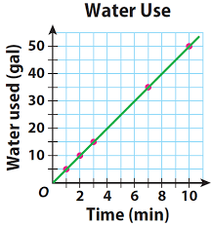
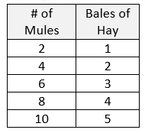
Standard Breakdown: Students need to be able to find the unit rate of two quantities (or more) and determine if they are proportional. This includes word problems, tables, equations, and graphs.
$$y=kx$$
For an equation to be proportional:
It must be in the format above
If it has anything added or subtracted from it, the equation is NON-PROPORTIONAL
For a graph to be proportional:
Must start at (0,0)
Must be positive
Must be a straight line
Must go up at a constant rate
For a table to be proportional:
Must have a COP—meaning all values MUST go up at the same rate

Slide 7
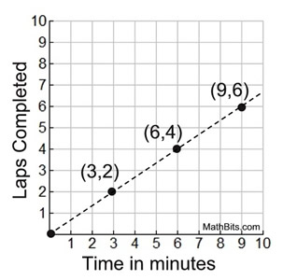
Standard Breakdown: Students need to be able to determine what any specific point on the graph represents in terms of the problem.
What does the point (3,2) represent on the graph?
That for every three minutes that has passed, the person can run 2 laps.
What does the point (6,4) represent on the graph?
That for every six minutes that has passed, the person can run 4 laps.
What does the pint (9,6) represent on the graph?
That for every 9 minutes that has passed, the person can run 6 laps.

Slide 8
Where does this come in for 8th grade math?
8.EE.5 & 6: Understand the connections between proportional relationships, lines, and linear equations.
Graph proportional relationships on an x,y coordinate grid and understand that the unit rate of the information is the slope.
Compare unit rates/slopes to each other
Use similar triangles to explain why slope, m, is the same between two points on a non-vertical line
Derive the equation $y=mx+b$ for a line intercepting the vertical axis at b (the y-intercept)
Basically you will be using unit rate to create equations for a graph on an x,y coordinate graph. Just building on what we have already learned!
But, don’t worry, that isn’t until next year!

Slide 9
Unit Rate Graphs and Tables Video Review
In this video the instructor is going to walk you through how to know if a table, graph, or equation are proportional.
Unit Rate in a Graph, Table, and Equation
In this video the instructor is going to show you how to find points on a graph, put them into a table, and then determine if they make a proportional graph or not.
How to Find the Unit Rate of a Graph
This video shows you how to look at different forms of unit rate (equations, tables, and graphs) and compare the different unit rates to see which one is the highest, lowest, etc.
Comparing Unit Rates

Slide 10
This website allows students to see two plus scenarios and determine if they are proportional (immediate feedback)
Unit Rate Word Problems Website
Khan Academy is a great website to utilize for practice and instructional videos on unit rate, this link will take you to unit rate practice.
Khan Academy Unit Rate Practice
This PDF allows students to compare unit rates on a table to determine which is the better deal. (PDF answer key included)
Comparing Unit Rate Tables PDF
Comparing Unit Rate Tables PDF ANSWER KEY

Slide 11
This is taken from the same workbook format that the students have seen for homework. It has practice problems for unit rate tables, word problems, and graphs. (Answer key PDF provided)
Unit Rate Tables and Graphs Practice PDF
Unit Rate Tables and Graphs Practice PDF ANSWER KEY
This PDF allows students to do specially skills practice with unit rate. (Answer key PDF included)
Unit Rate Skills Practice PDF
Unit Rate Skills Practice PDF ANSWER KEY

Slide 12
Unit Rate Challenge Worksheet PDF
This this is all the other stuff is too easy? GOOD! Why don’t you try out this riddle worksheet and see if you can do it! Challenge yourself!! PDF link above and answer keys to the left!
Unit Rate Challenge Worksheet Key FRONT
Unit Rate Challenge Worksheet Key NUMBER 3 Work
Unit Rate Challenge Worksheet Key NUMBER 5 Work Part 1
Unit Rate Challenge Worksheet Key NUMBER 5 Work Part 2

Slide 13
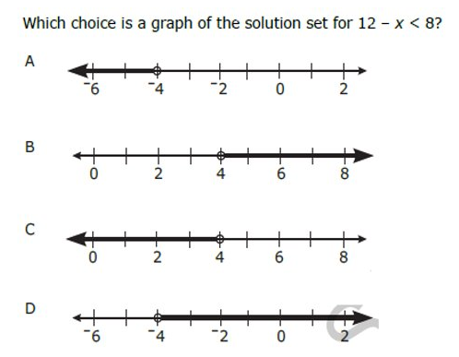
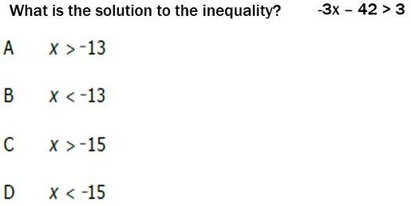
Review Practice
1.)
2.)
3.)
4.)
6.) Solve and graph the inequality:
5.) Find the solution: $−3x−42>3$

Slide 14
Review Practice Answers
1.) $4.44 per box of chicken 2.) 6 miles per hour
3.) 10.5 gallons per hour 4.) Answer Choice “B”
5.) Answer Choice “D” 6.) $x ≥ 3$
$$−3$$
$$0$$
$$3$$

