Slide 1
Week three - going strong!!! We are moving forward with unit rate! Now, this weeks PowerPoint will just be a reintroduction to unit rate, how to find it, etc. and next week’s PowerPoint will be finding unit rate on graphs and tables.
Remember: Now, none of this is a requirement. You do NOT have to do all the practice, watch all the videos, or anything like that. This is simply a tool for you to utilize to prepare you for next year if you choose to do it! Also, you do NOT need to print anything out to work it! Just use a sheet of paper!
You guys are amazing and I miss y’all so much!
Stay safe and healthy, tiny children!!

Slide 2
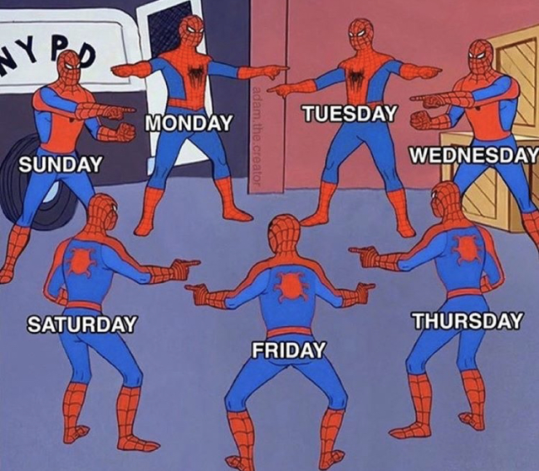
WE MISS YOU TOO !

Slide 3
What have you been up to?
I know some of you are loving this quarantine, while others not so much. I have been trying to stay busy with finding resources for you all, helping my own kids with their schoolwork and some painting.
One thing I did not want to happen was the fire department show up at my house. We got a new microwave in January but the other day it decided it want to keep cooking (while I walked away). I think, we, as humans, depend on beeps and alarms, etc. to remind us what we were doing. Well anyway, I put some chicken nuggets in the microwave for Nate, went to the laundry room then to the living room. Suddenly, the fire alarm was going off. I ran to the kitchen to find smoke everywhere! The microwave did not shut off after 1 minute 30 seconds, it kept going! The alarm company called but they had already dispatched the fire department. There was no fire, just a lot of smoke. See the picture on the next slide of what was chicken nuggets. Nate hasn’t asked for anymore chicken nuggets My house still smells like smoke ☹
I would love to hear from you all! I really do miss you and hope we get to see each other soon! Send me a message on Teams or email me!

Slide 4
It smells worse than it looks, I promise!

Slide 5
Week 3: April 6-10 Introduction to Unit Rate Review
DCMS 7th Grade Math
April 2020

Slide 6
Standard Breakdown: Students need to be able to compute unit rate and determine if a relationship is proportional given a real-world scenario.
Example:
A skydiver falls 144 feet in 3 seconds. How far do they fall in 1 second?
Step 1: find the important information—
144 feet in 3 seconds
Step 2: figure out what the question is asking you—
How far will they fall in 1 second? (Unit Rate is ONE of something)
Step 3: set up your ratio to find the unit rate—
$$\frac{144 feet}{3 seconds}=\frac{x feet}{1 seconds}$$
Cross multiply.
Remember: Like terms across from each other in the ratio. In this example: feet is across from feet and seconds is across from seconds
$$144 feet∙1 second=3 seconds∙x feet$$
Simplify.
$$144=3x$$
Divide each side by 3 to find the unit rate.
$$x=48 feet per second$$

Slide 7
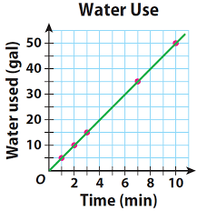
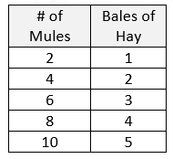
Standard Breakdown: Students need to be able to find the unit rate of two quantities (or more) and determine if they are proportional. This includes word problems, tables, equations, and graphs.
$$y=kx$$
For an equation to be proportional:
It must be in the format above
If it has anything added or subtracted from it, the equation is NON-PROPORTIONAL
For a graph to be proportional:
Must start at (0,0)
Must be positive
Must be a straight line
Must go up at a constant rate
For a table to be proportional:
Must have a COP—meaning all values MUST go up at the same rate

Slide 8
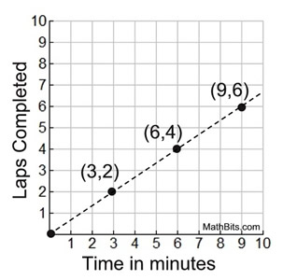
Standard Breakdown: Students need to be able to determine what any specific point on the graph represents in terms of the problem.
What does the point (3,2) represent on the graph?
That for every three minutes that has passed, the person can run 2 laps.
What does the point (6,4) represent on the graph?
That for every six minutes that has passed, the person can run 4 laps.
What does the pint (9,6) represent on the graph?
That for every 9 minutes that has passed, the person can run 6 laps.

Slide 9
Where does this come in for 8th grade math?
8.EE.5 & 6: Understand the connections between proportional relationships, lines, and linear equations.
Graph proportional relationships on an x,y coordinate grid and understand that the unit rate of the information is the slope.
Compare unit rates/slopes to each other
Use similar triangles to explain why slope, m, is the same between two points on a non-vertical line
Derive the equation $y=mx+b$ for a line intercepting the vertical axis at b (the y-intercept)
Basically you will be using unit rate to create equations for a graph on an x,y coordinate graph. Just building on what we have already learned!
But, don’t worry, that isn’t until next year!

Slide 10
Unit Rate Video Review!
The video link to the right is going to take you to a YouTube video that will walk you through what Unit Rate is, how to find it, and important definitions that you will need when solving unit rate.
Introduction to Unit Rate
The video link to the right is going to take you to a Khan Academy video where they will walk you through how to solve a unit rate problem that involves complex fractions.
Khan Academy: Complex Fraction Unit Rate
The video link to the right is going to take you to a YouTube video with more examples of unit rate with complex fractions.
Complex Unit Rate

Slide 11
This PDF worksheet has complex fractions that has clear examples and vocabulary. (answer key included)
Unit Rate With Complex Fractions PDF
This PDF worksheet has unit rate word problems and allows students to practice setting them up (answer key included)
Understanding Unit Rate PDF
This website will give immediate feedback to students as they practice finding unit rate (whole number unit rate)
Unit Rate Practice Website
https://www.ixl.com/math/grade-7/unit-rates
https://www.ixl.com/math/grade-7/unit-rates

Slide 12
Khan Academy is a really good resource to allow students to practice unit rate and get immediate feedback. You can also practice different types of unit rate problems as you navigate the website.
Khan Academy Unit Rate Practice Website

Slide 13
Review Practice
1.) $\frac{y}{6}−3=−11$ 2.) $4\left(g−1\right)=2$
3.) $\frac{y+9}{15}=0$ 4.) $\frac{x}{−4}−4≥−6$
5.) $2x−5>19$ 6.) $\frac{(3x−2)}{8}>5$
*please graph all inequalities on a number line

Slide 14
Review Practice Answers
1.) $y = −48$ 2.) $g=1\frac{1}{2}$
3.) $y = −9$ 4.) $x ≤ 8$
5.) $x > 12$ 6.) $x > 14$
$$−8$$
0
$$8$$
$$−12$$
0
$$12$$
$$−14$$
0
$$14$$

